Slide 1
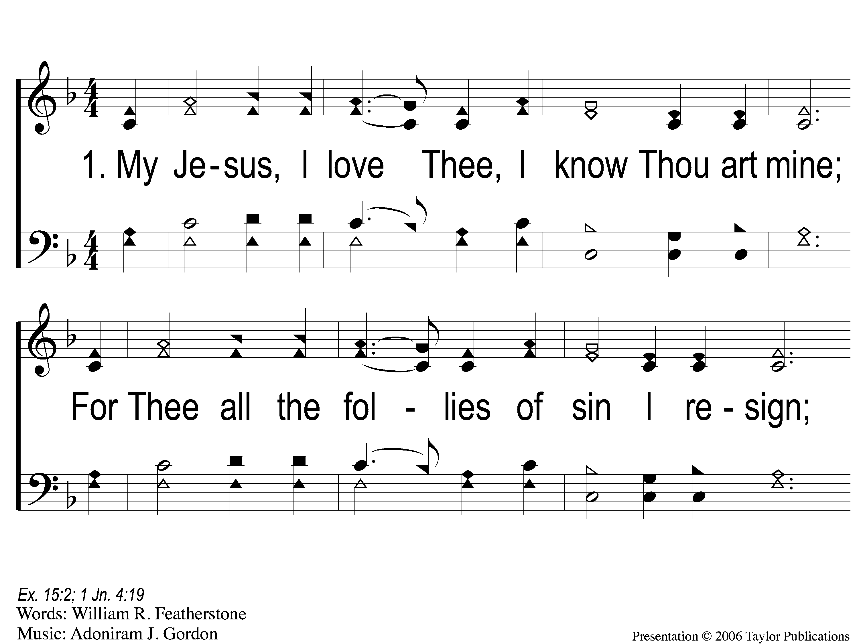
1-1 My Jesus I Love Thee
My Jesus, I Love Thee
142

Slide 2
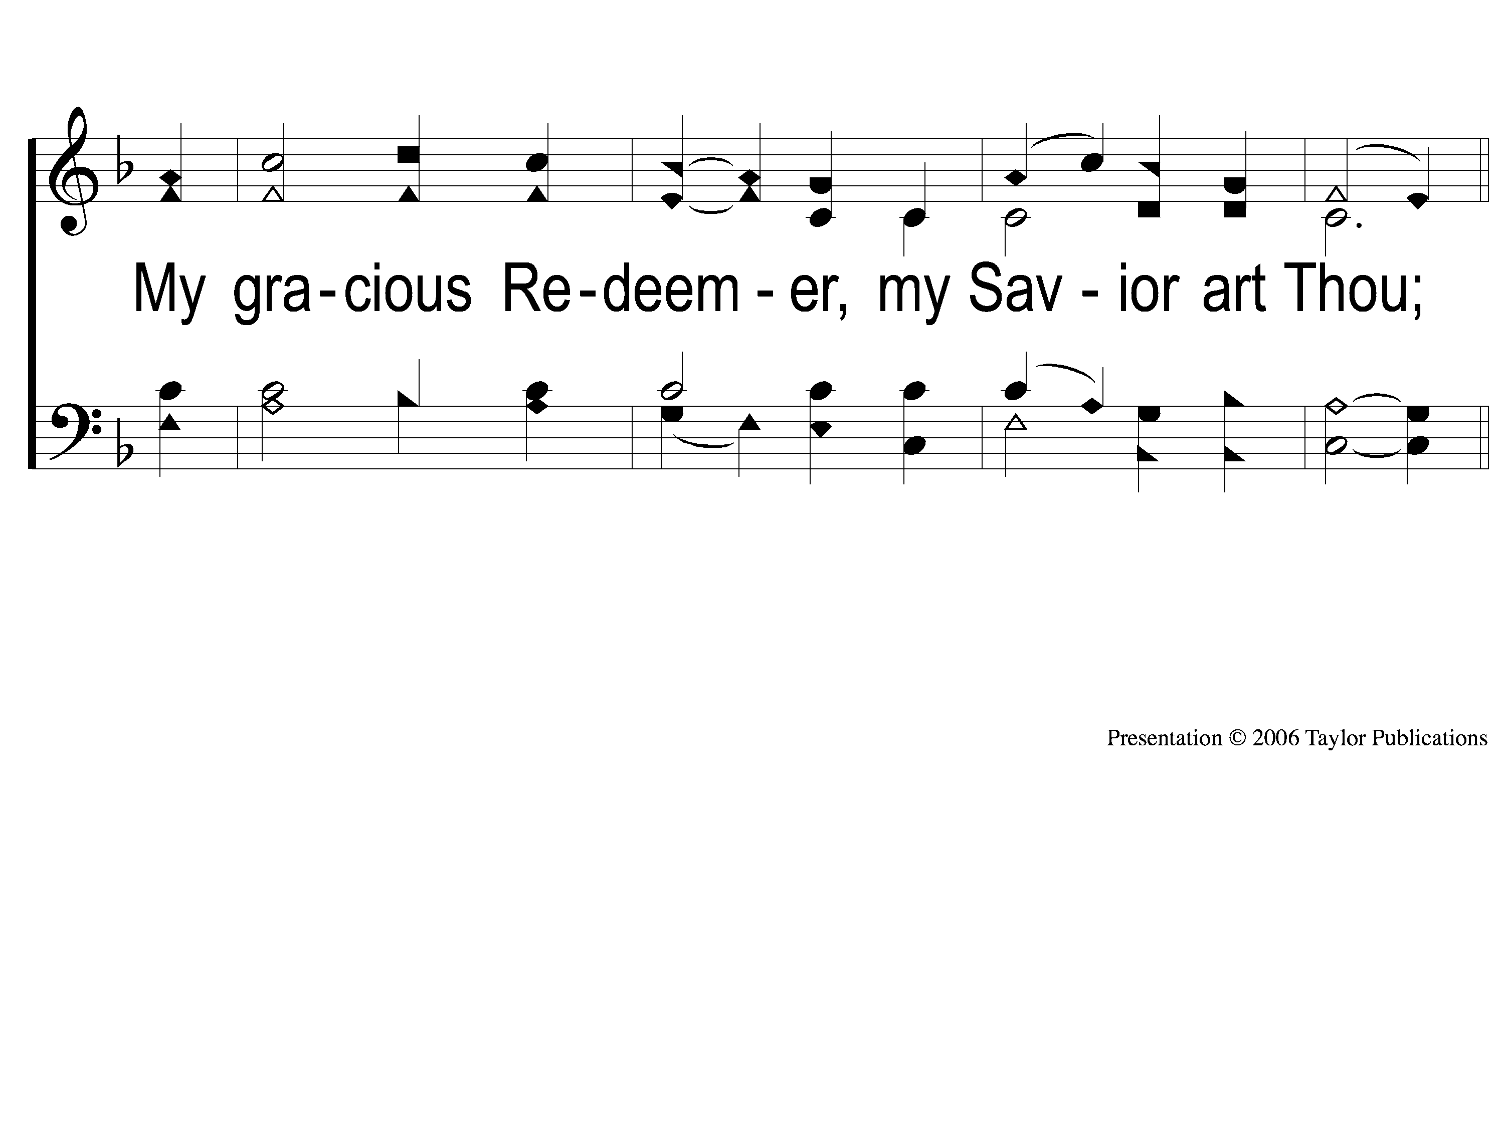
1-2 My Jesus I Love Thee
My Jesus, I Love Thee
142

Slide 3
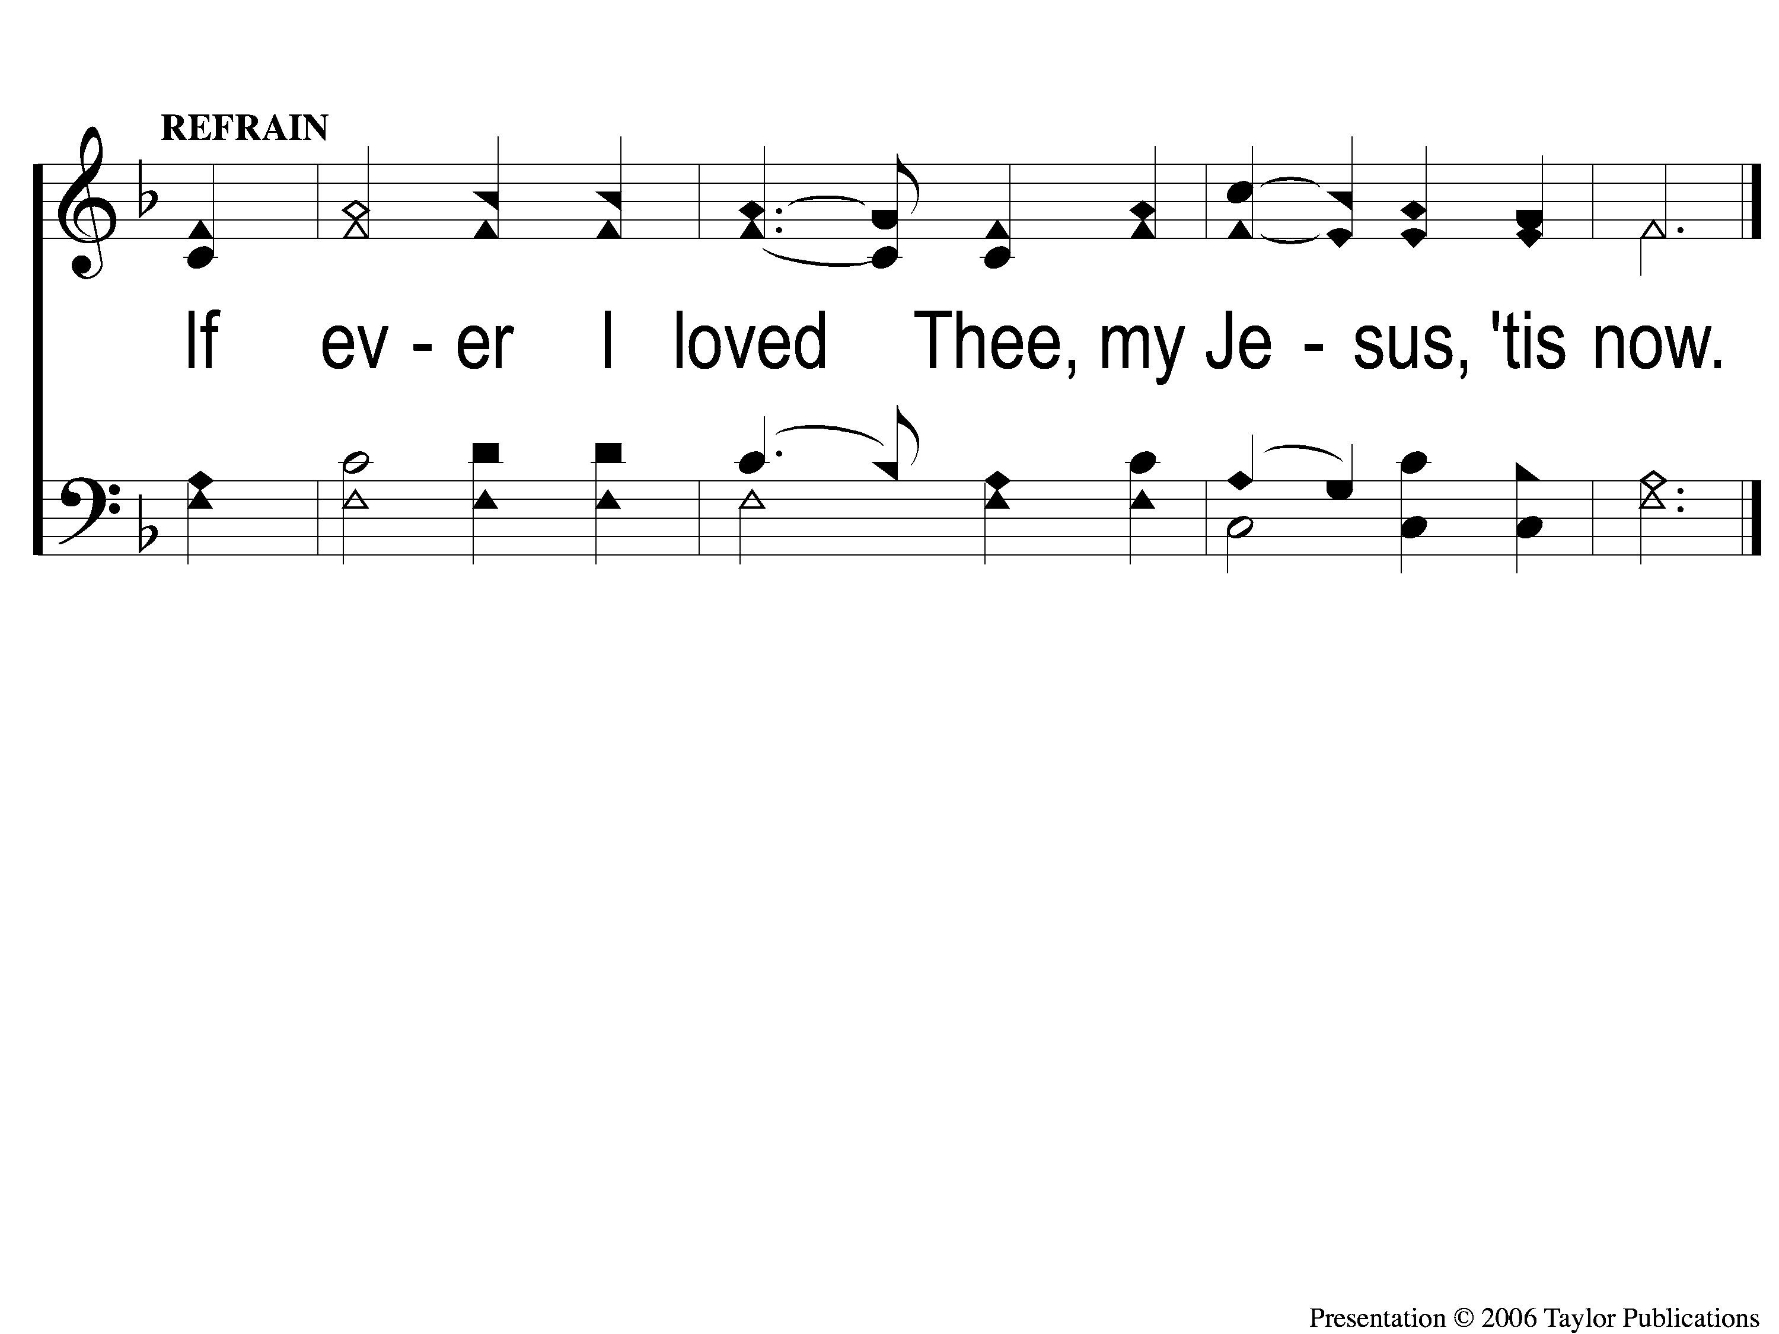
C My Jesus I Love Thee
My Jesus, I Love Thee
142

Slide 4
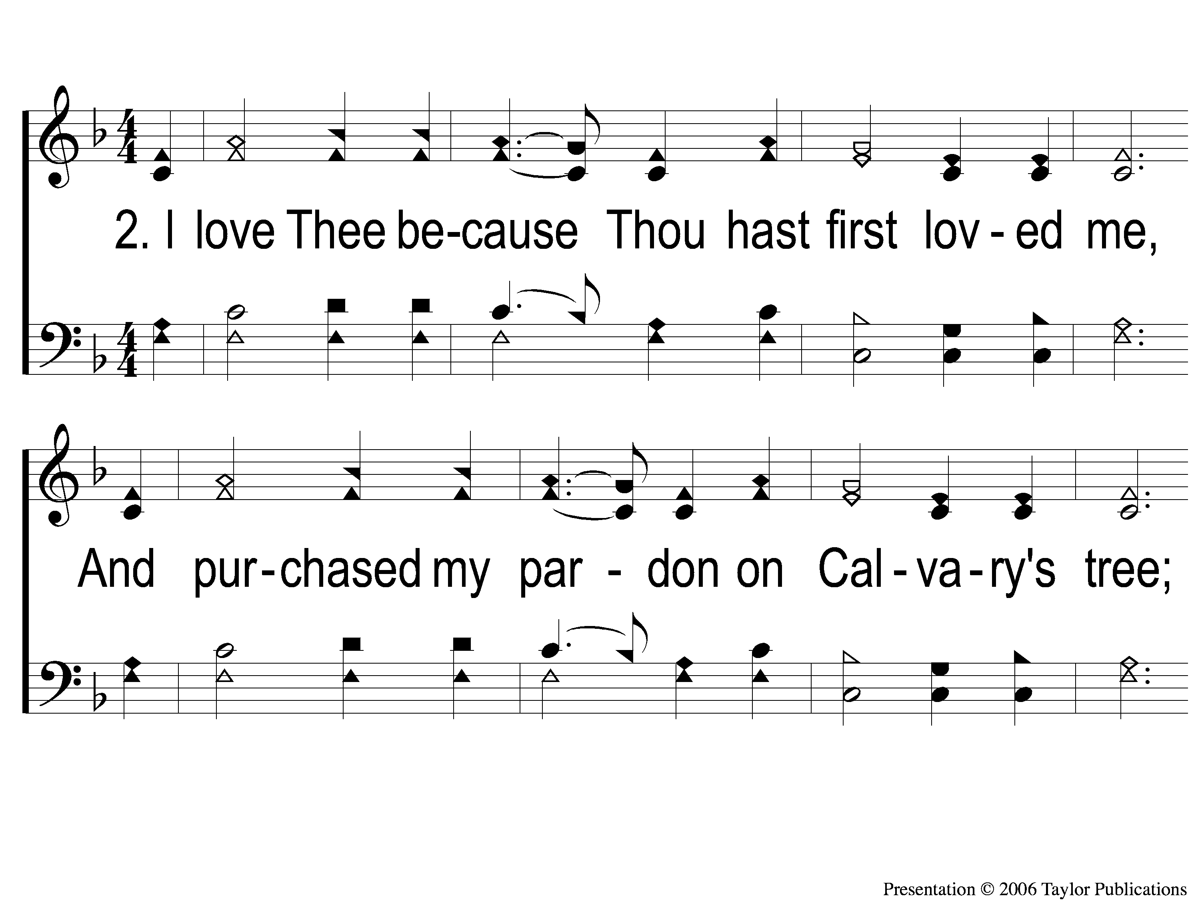
2-1 My Jesus I Love Thee
My Jesus, I Love Thee
142

Slide 5
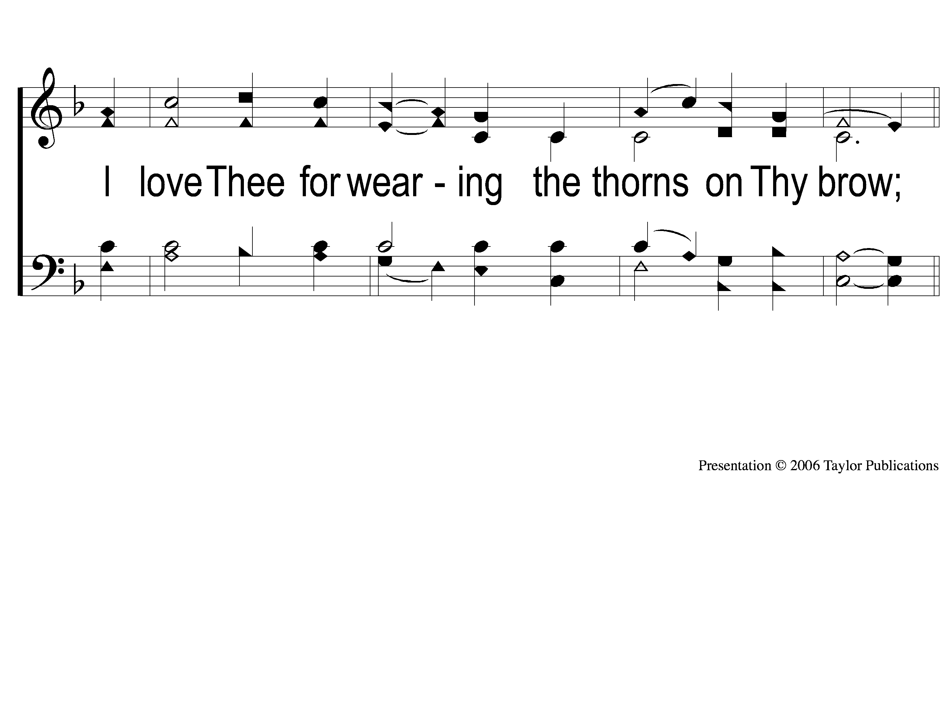
2-2 My Jesus I Love Thee
My Jesus, I Love Thee
142

Slide 6
C My Jesus I Love Thee
My Jesus, I Love Thee
142

Slide 7
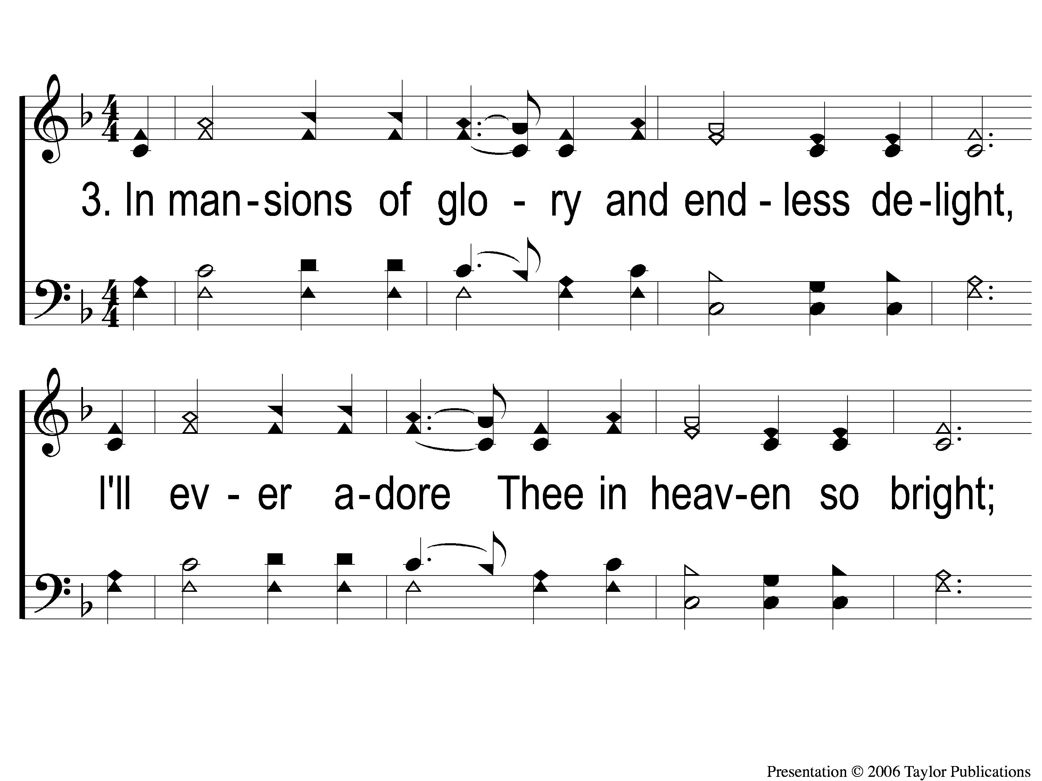
3-1 My Jesus I Love Thee
My Jesus, I Love Thee
142

Slide 8
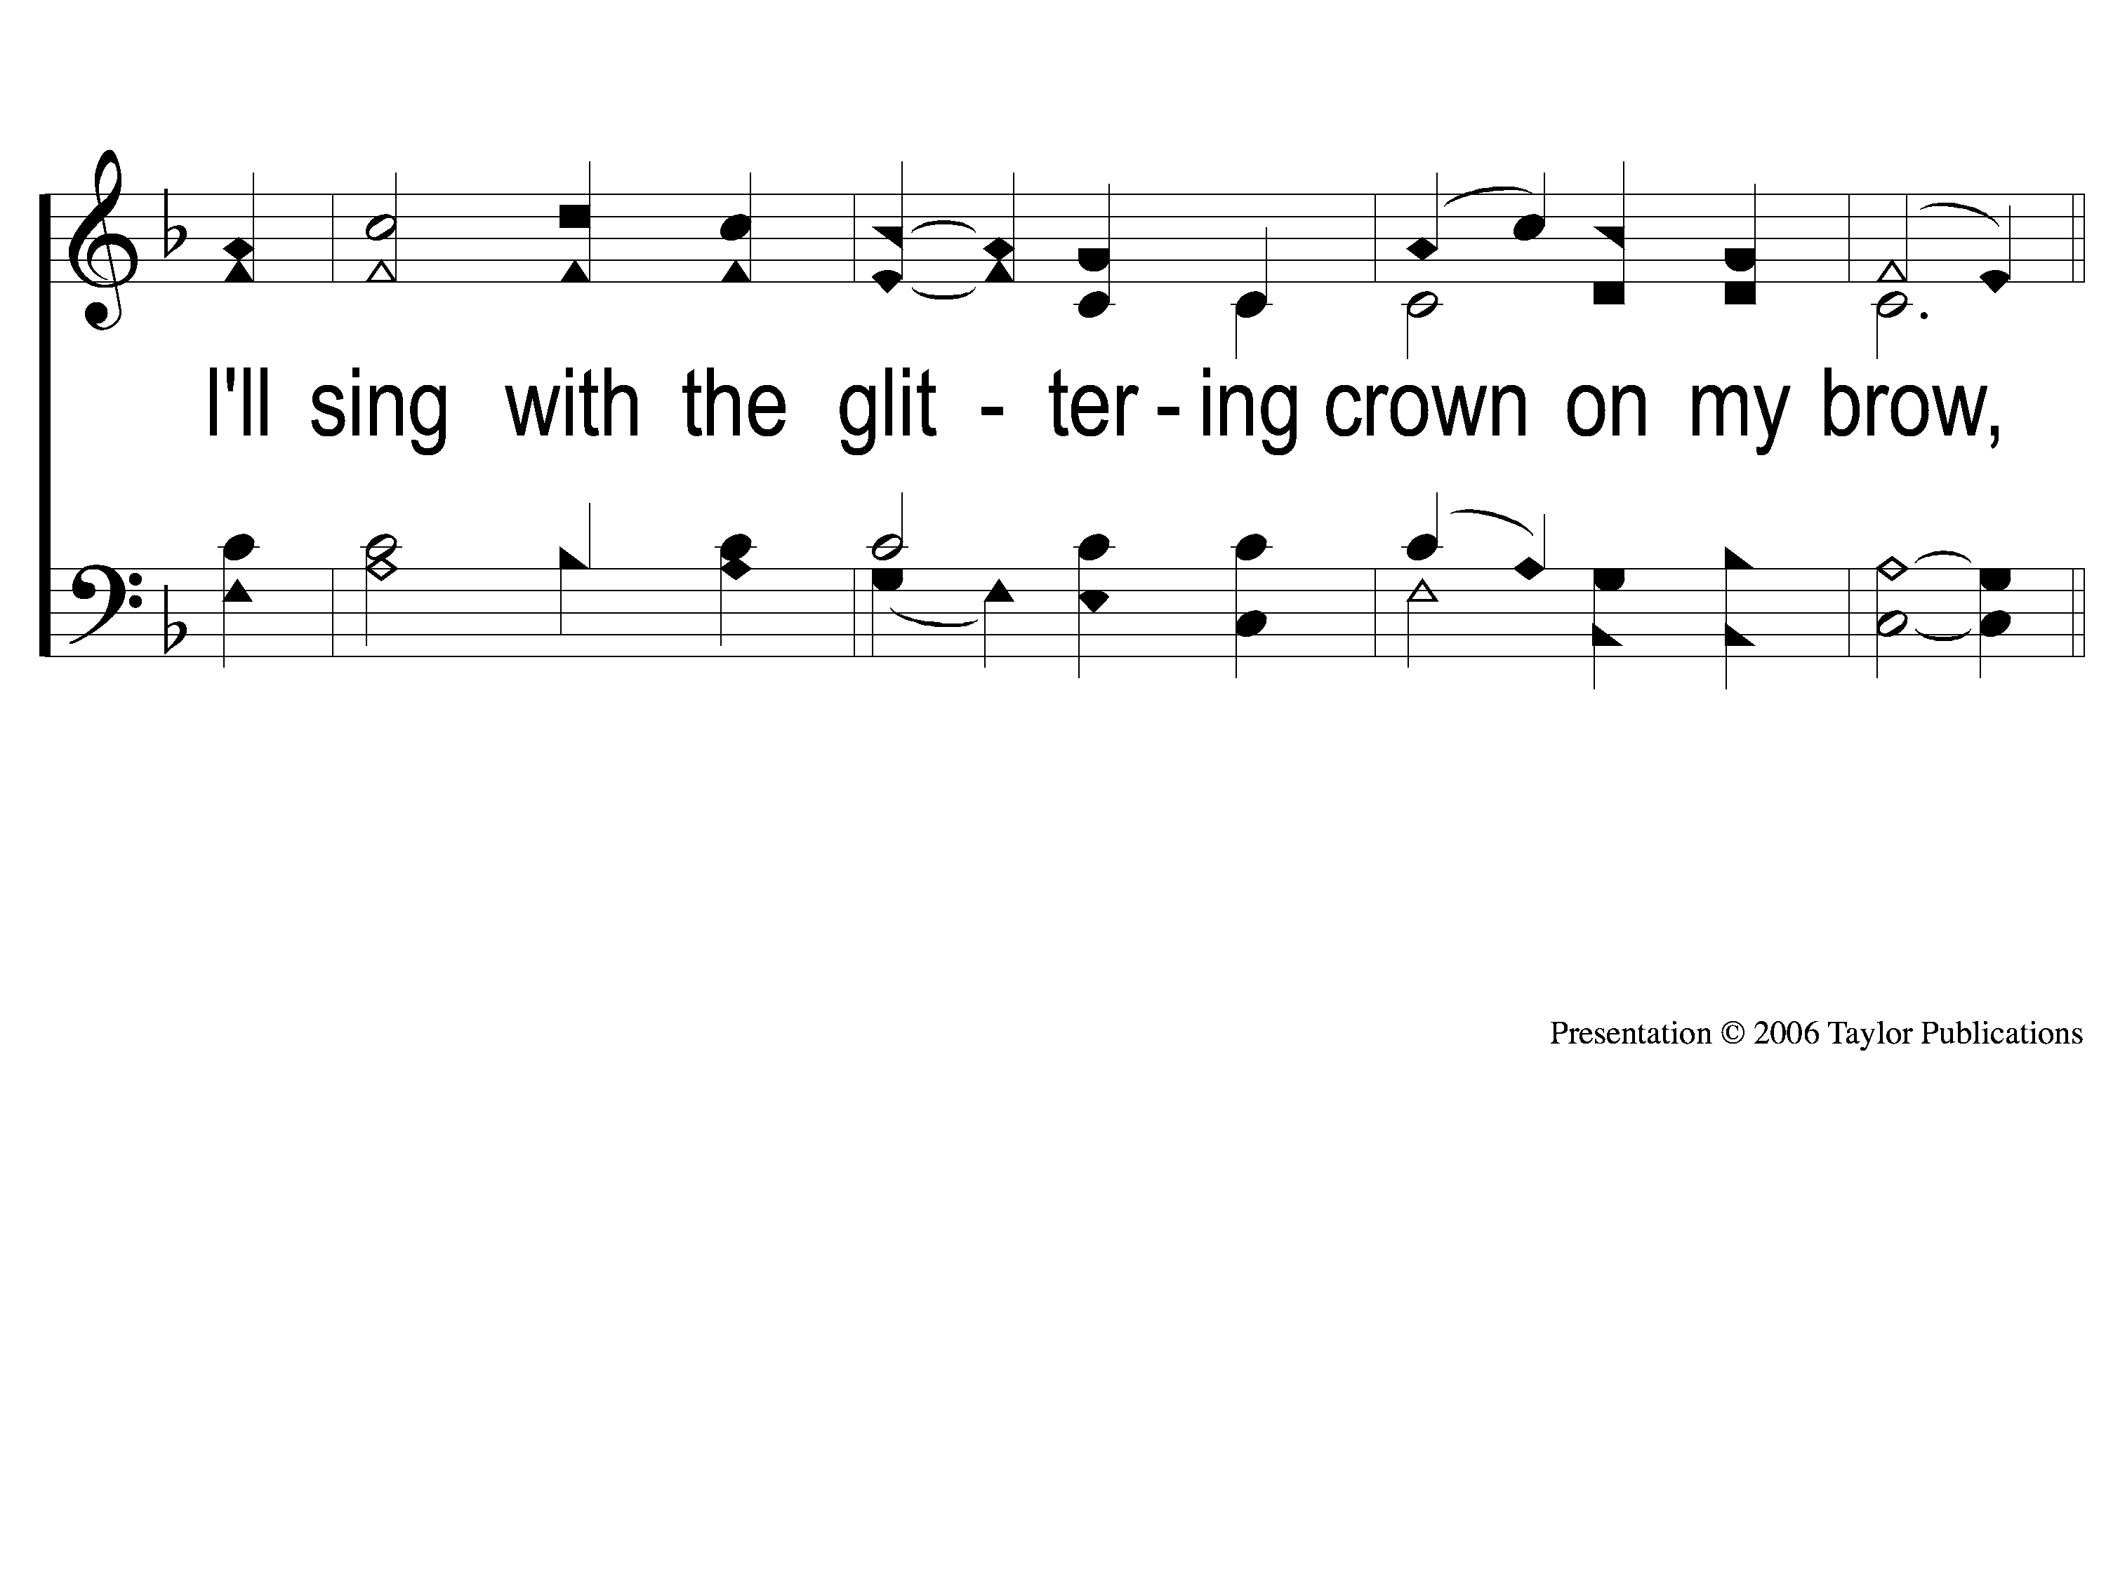
3-2 My Jesus I Love Thee
My Jesus, I Love Thee
142

Slide 9
C My Jesus I Love Thee
My Jesus, I Love Thee
142

